Slide 1
Purulent diseases
of serous cavities

Slide 2
Purulent pleurisy, empyema pleurae
- purulent inflammation of a parietal and visceral pleura
In most cases is a secondary disease.

Slide 3
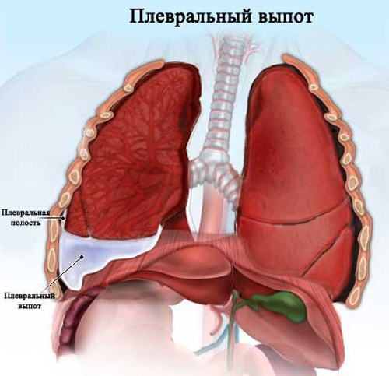

Slide 4
Classification:
Etiology:
-Streptococcal
-Pneumococcal
-Staphylococcal
-Mixed
On an arrangement pus:
The free:
  Total
  Average
  Small
The encapsulated:
On character of exudate:
The purulent
The putrefactive
The purulent - putrefactive
Pyopneumothorax
Haemopyothorax
The multichamber The single-chamber | Basal Parietal Midlevel Apical
On a clinical current:
The acute
The chronic

Slide 5
Patogenez:
Acute purulent pleurisy is complication of abscess of a lung, pleuropneumonia, influenzal pneumonia, gangrenes of a lung, the wounds getting into a pleura. Develops at infection of a parasitic or congenital cyst, disintegration of a malignant tumour, break of a tubercular cavity in a pleural cavity etc.
Infection of a pleura can occur a hematogenous or lymphogenous way from the infection centres.
The weakly virulent flora causes formation of a small fibrinogenous exudate that promotes formation of solderings (dry pleurisy). More virulent microbes cause an active exudation- exudative pleurisy which can gain purulent character.

Slide 6
Patogenez:
The inflammation begins with a hyperemia, hypostasis, an ekssudation, dot hemorrhage, fibrin adjournment.
Pleura infiltrating the leukocytes forming pus. At the bottom of a pleural cavity pus dense, with granulated masses, in more blankets – liquid. In the most top layer – transparent exudate.
Upon transition of process to a productive phase solderings, adhesions, bringing to an encysted empyemaare formed.

Slide 7
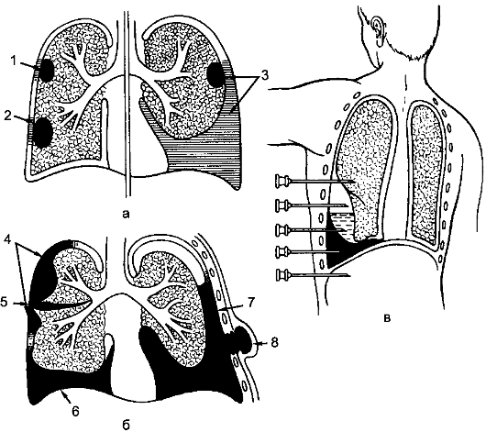

Slide 8
Clinic:
Stitch, heavy feeling.
The cough, the complicated breath, short wind.
Body temperature increase (39-40⁰С), tachycardia (120-130 in mines), weakness.
Restriction of excursion of a thorax, backlog of the sick party from the healthy. At an exudate congestion a thorax bulging in back-lower departments, intercostal intervals are maleficiated.
Voice trembling is weakened or is not carried out.
At a perkussion – sound shortening over exudate. At a considerable congestion of exudate – Demuazo's line, Garlend and Grokko-Raukhfusa's triangles. Mediastinum shift in the healthy party.
Auskultation – considerable easing or total absence of respiratory noise over exudate.
In blood: leukocytosis, shift of a leukocytic formula to the left, increase in erythrocyte sedimentation rate
Roentgenogram: a liquid congestion in a pleural cavity.

Slide 9
Patients purulent pleurisy complain of pain in his side, coughing, feeling of heaviness or fullness in the side, shortness of breath, inability to take a deep breath, shortness of breath, fever, weakness. Pain in the chest is more pronounced at the beginning of the disease, is an itchy in nature, and as the spread of inflammation and accumulation of exudate weakened, joins a feeling of heaviness or fullness in the side. Gradually increasing shortness of breath. Cough, usually dry, and when the secondary pleurisy on the grounds of pneumonia or lung abscess - with sputum mucoid or purulent character, sometimes with copious amounts of purulent sputum.

Slide 10
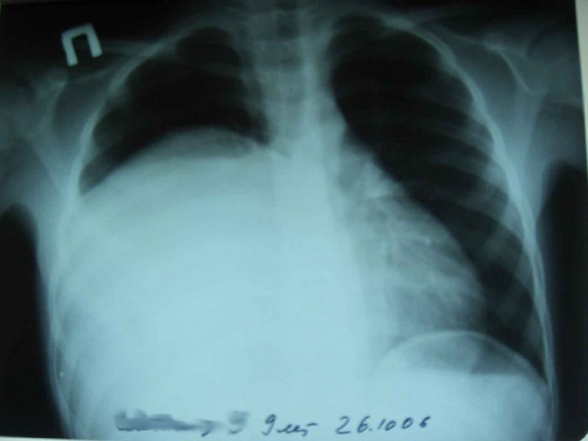
Pleurisy. Direct projection

Slide 11
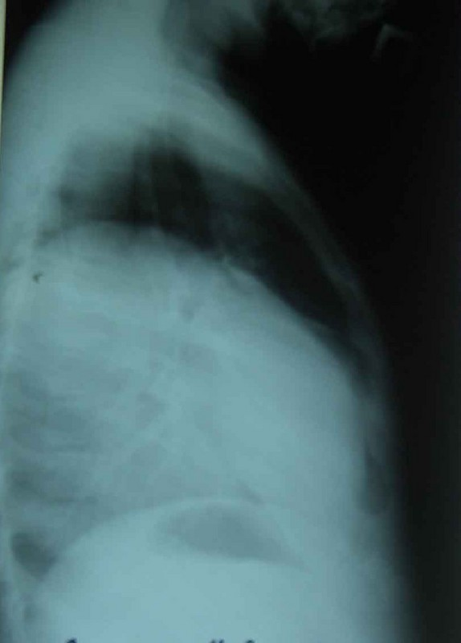
Pleurisy. Lateral projection

Slide 12
Pleural shock
Abscess break in a pleural cavity is accompanied by pleural shock. It is preceded by painful cough which comes to the end with a sharp stitch («blow with a dagger»). Skin pale, is covered cold then. Pulse frequent, weak filling, the AP it is lowered. Breath superficial, frequent, accrues short wind. Acrocyanosis.

Slide 13
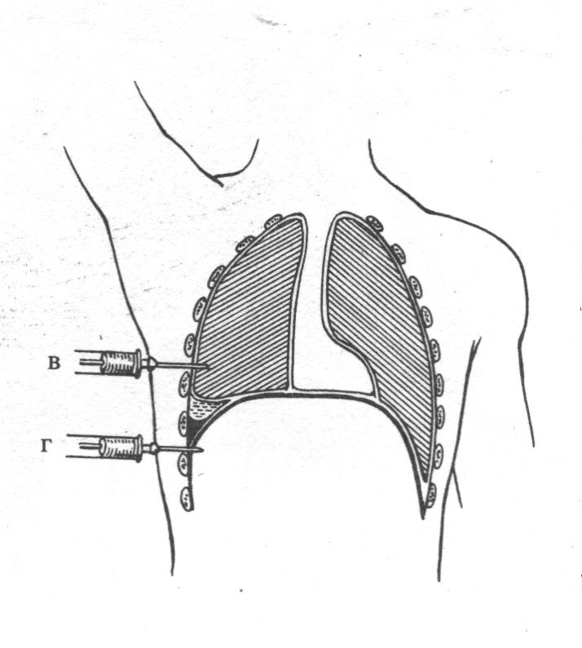
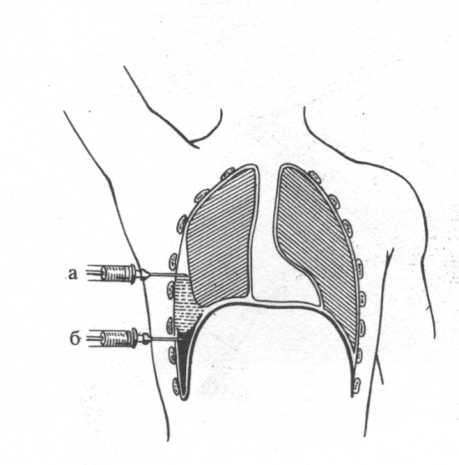
Scheme of a puncture of a pleural cavity and possible complications
A – the needle has passed in a pleura cavity over an exudate
B – the needle has passed in soldering between pleura leaves
C – the needle has passed over an exudate in a lung tissues
D – the needle is passed through the lower part of the rib-diaphragmatic sinus in the abdominal cavity

Slide 14
Treatment
Therapy of purulent pleurisy involves removal of pus, infection control, detoxification therapy, restoration of disturbed functions of the organs.
Rapid elimination of purulent inflammation in the pleura and light smoothing is achieved the main goal of treatment is to contact the parietal and visceral pleura and their fusion. Coming obliteration purulent cavity leads to recovery of the patient. The earlier you start the treatment of empyema, the better the outcome, because spasams light still do not have time to undergo irreversible changes, and in the inflamed pleura has not formed a dense fibrous tissue.

Slide 15
The main method of treatment of pleurisy - closed at which do not make opening of a pleural cavity. At an open method carry out a cut of a chest wall for removal of pus, fibrin.
Medical punctures of a pleural cavity belong to the closed methods of treatment of purulent pleurisy and drainage its way of a puncture of a chest wall. The drainage tube can be deduced also through a bed of a remote edge, having sewn up round it soft tissues for tightness creation.
Begin treatment of purulent pleurisy with punctures of a pleural cavity. Carry surely out local anesthesia. A puncture carry out a needle with a wide gleam (1-1,5 mm), surely using the three-running crane or a rubber tube with a clip with which block a needle at a syringe detachment. It allows to avoid pyopneumothorax owing to hit of atmospheric air in a pleural cavity. To delete pus at its big congestion in a pleural cavity follows slowly not to cause owing to a fast clarification of a cavity a hyperemia and sharp shift of a mediastinum.

Slide 16
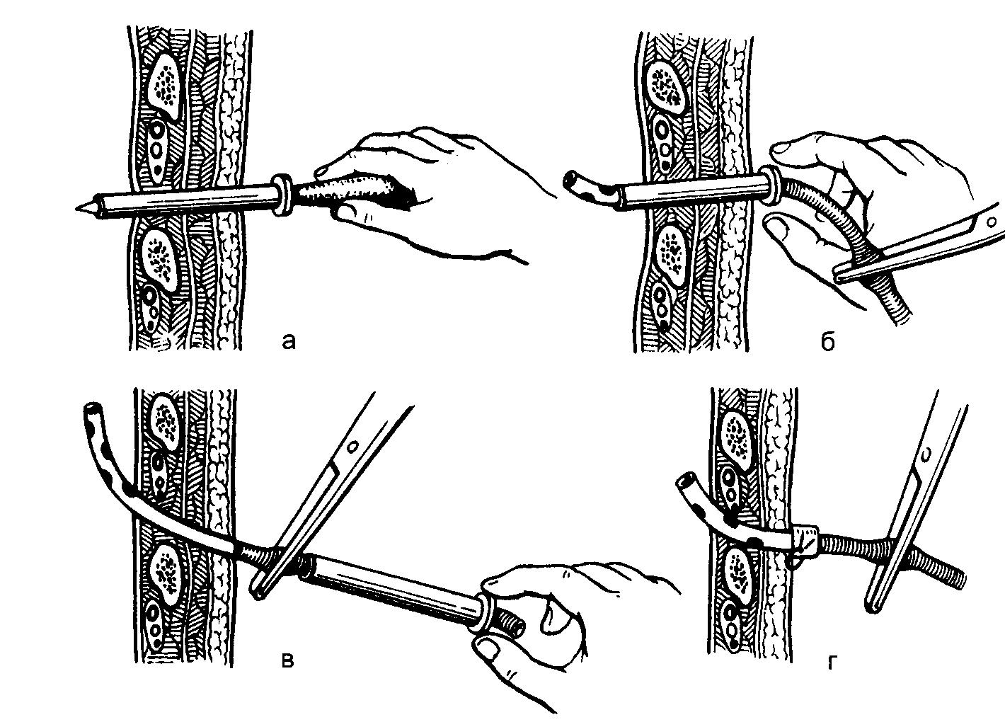
Treatment:
drainage of a pleural cavity:
  а) puncture
  б) carrying out trocar
  в) removal cannula trocar
  г) drainage fixing
At an inefficiency of the closed methods - a toracostomiy

Slide 17
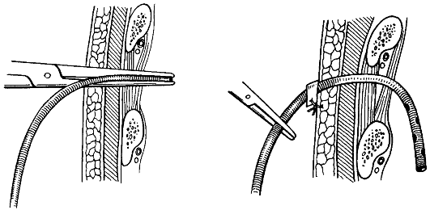

Slide 18
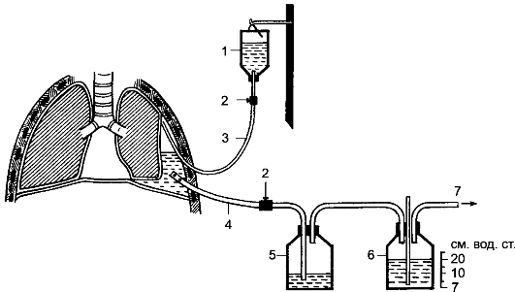

Slide 19
Purulent pericarditis
Pathogens: Staphylococcus aureus, enterobacteria, gonorrhea, tubercle Bacillus.
The disease mainly secondary complication of purulent mediastinitis, liver abscess, purulent pleurisy, peritonitis, osteomyelitis, cellulitis, etc.
The main way of distribution - lymphogenous, at least - hematogenous and contact.

Slide 20
Clinic and diagnostics
Symptoms of purulent intoxication:
-Fever, chills
-Weakness, lethargy, lack of appetite
-Leukocytosis with neutrophilia in the blood and so on
When the accumulation of a large number of symptoms of compression of the heart:
-Palpitation, pain in the heart, the feeling of embarrassment, fear
-The pulse is soft, uneven, intermittent
-Shortness of breath, forced body position (semi-sitting), participation in the act of auxiliary breathing muscles
-Cyanosis, swelling of neck veins
When compression of the trachea and esophagus - cough, or difficulty swallowing
Percussion: expanding borders of cardiac dullness, triangular shape
Auscultation: In early phases - the pericardial friction noise, then deafness tones
RADIOGRAPH: intensive triangular shadow in the heart
ECG, puncture of the pericardium and bacterial examination of exudate

Slide 21
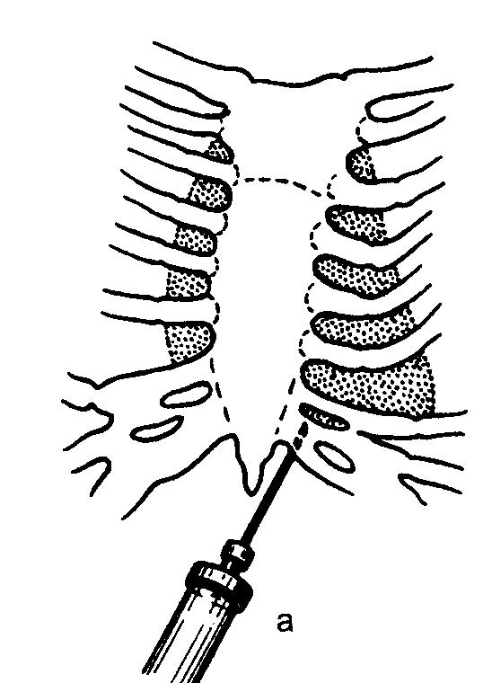
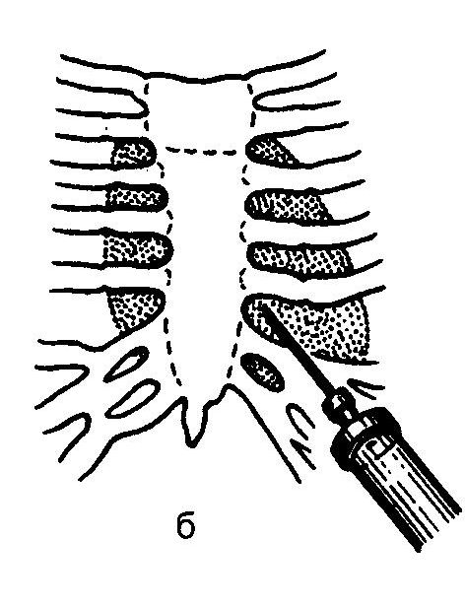
Pericardium puncture
Through 5 intercostal space on the parasternal line
At the basis of a xiphoid process

Slide 22
Treatment:
Antibacterial therapy
Disintoxication (infusion) therapy
Repeated punctures of a pericardium (in 3-5 days) for removal of pus and introduction of antibiotics
In the absence of effect – a pericardiotomy – a cut make at a xiphoid process, bare the top surface of a diaphragm and a pericardium which open over a diaphragm. After evacuation of pus enter a drainage

Slide 23
Peritonitis:
- an inflammation of the parietal and visceral peritoneum, being accompanied the expressed local changes and intoxication.
Classification
I. Peritonitis sources:
  Acute inflammatory diseases of abdominal organs
  Тraumatic damages of abdominal organs and retroperitoneal space
  Рostoperative complications
  Unstated source

Slide 24
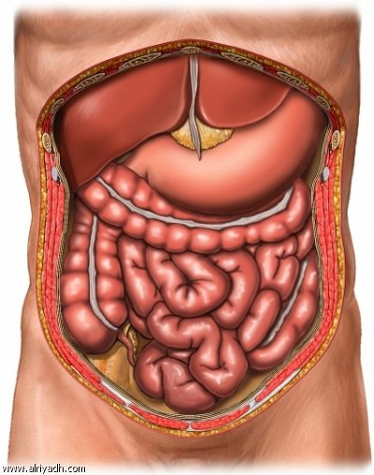

Slide 25
Classification:
II. On prevalence of process:
  Limited (to two areas of an abdominal cavity)
  Extended (more than two areas or total defeat of a peritoneum)
III. Character of exudate:
  The purulent
  The bilious
  The Fecal
  The mixed
IV. Toxicosis stages:
  I, II, III – toxaemia stages
  IV – organ insufficiency

Slide 26
Etiology and sources of infection
The development of peritonitis cause a variety of pyogenic microorganisms (Staphylococcus, Proteus, E. coli, anaerobes). Most (85-90%) of its causes bacterial flora, trapped in the abdominal cavity from the external environment when the wounds, operations or from hollow organs of the abdominal cavity at their inflammation, perforation. Damage to the peritoneum with the injuries of the abdomen, closed injuries during operation, cooling and drying of the peritoneum during long-term manipulations, the effect on the peritoneum chemical antiseptic products (iodine, alcohol) contribute to the development of aseptic inflammatory reaction.

Slide 27
Patogenez of purulent peritonitis
Development of inflammatory process in a peritoneum depends on degree of a bacterial obsemenyonnost and a species of microorganisms, a condition of immunological forces and reactance of an organism, mechanical, physical, chemical damage of a peritoneum. At the beginning of a peritoneum inflammation primary center seldom happens is delimited by solderings from a free abdominal cavity. In the course of its development occur pasting of leaves of a peritoneum on borders of the inflammatory center and emergence of solderings which at fast education can lead to an localisation of inflammatory process.

Slide 28
Clinical manifestations
In the first 12-24 h peritonitis is characterized by increasing inflammatory changes in the peritoneum. Patients complain of intense pain in the abdomen, which are initially localized at the location of the source of peritonitis, and then spread to adjacent areas, can capture half of stomach or belly. Often there is vomiting of gastric contents, then bile. Common clinical manifestations of the disease are expressed in body temperature rise up to 38 °C and above, tachycardia (pulse quickens up to 120 per minute), increased blood pressure, increased respiration (up to 24-28 per minute), anxiety, motor excitation.
The first person hyperemic, and then becomes pale. Stomach or moderately swollen, abdominal wall, or half of it in the act of breathing is not involved.

Slide 29
Mannheim index of peritonitis (MIP)
risk factor | weight assessment, points
-the age is more senior than 50 years | 5
-female | 5
-existence of organ insufficiency | 7
-existence of a malignant tumour | 4
-duration of peritonitis more than 24 hours | 4
-thick gut as peritonitis source | 4
-peritonitis diffusive | 6
-exudate:
the transparent | 0
the muddy and purulent | 6
the fecal-putrefactive | 12

Slide 30
Severity on MIP:
I degree – 20 points – a lethality of 0 %
II degree – 20-30 points – a lethality of 29 %
III degree – more than 30 points – a lethality of 100 %

Slide 31
Treatment:
Emergency operation, including:
-elimination of the source of peritonitis,
-sanitation of the abdominal cavity,
-the drainage of the abdominal cavity.
Treatment in the postoperative period:
-Sanation of abdominal cavity
-Antibiotic therapy
-Detoxification therapy
-Correction of metabolic disorders
-Recovery of motor-evacuation function of the intestine

