Slide 1
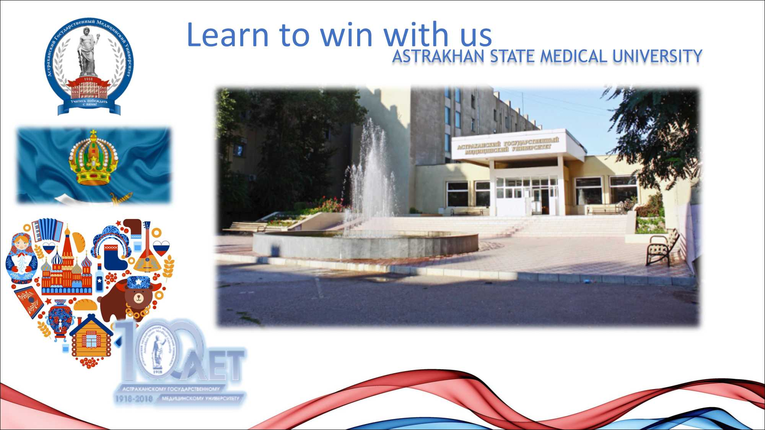

Slide 2

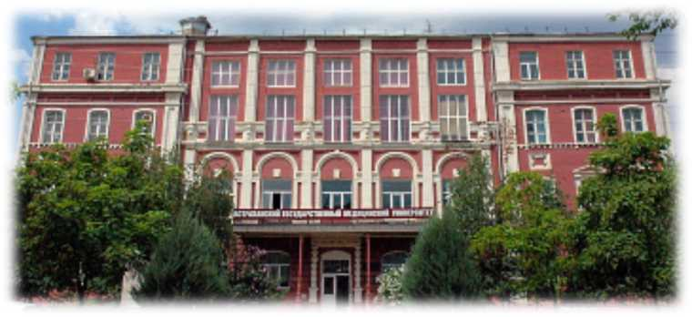
HISTORY OF ASTRAKHAN STATE MEDICAL
UNIVERSITY
Astrakhan State Medical University - the oldest higher educational institution of Astrakhan region - was founded in 1918, as the Medical Faculty of Astrakhan University. In 1922 it was transformed into a Medical Institute. For a long period, students and teachers fought against the cholera epidemic. During its existence, it gave the country more than 40000 doctors.
In 1988, the museum of the history of the university was opened, in 1993 - faculties for the improvement of doctors, postgraduate training, foreign students. In 2018 Astrakhan State Medical University celebrated its hundred years anniversary.

Slide 3
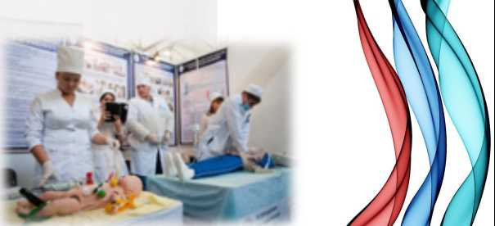


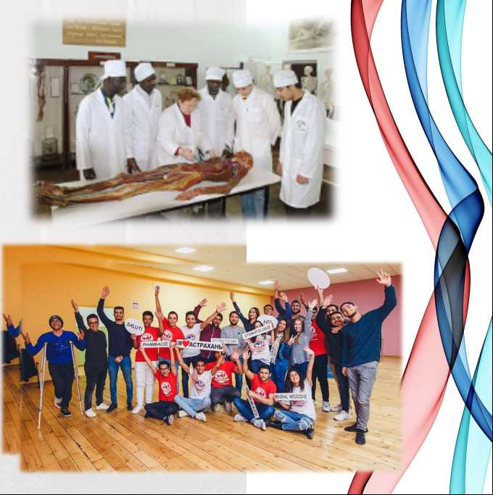




ASTRAKHAN STATE MEDICAL UNIVERSITY TODAY
More than 4000 students from
32 regions of the Russian Federation study at the University
lLl
There are over 2500 foreign students from
57 countries
6 educational programs of higher education
3 languages of educational programs of higher education
More than 50 educational postgraduate programs

Slide 4



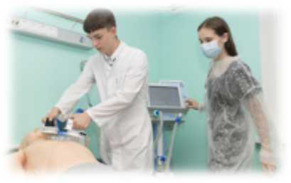
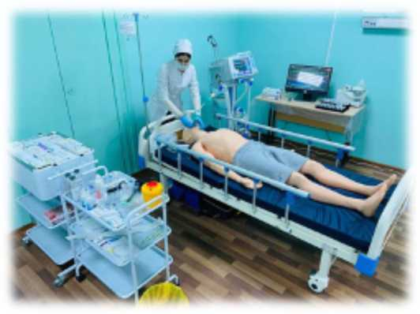


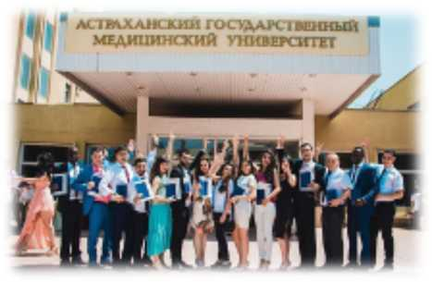

ASTRAKHAN STATE MEDICAL UNIVERSITY TODAY
1st place in the category «Cooperation, internationalization or international activity of the university» among Astrakhan universities
400 candidates and doctors of sciences
17 scientific schools
1 simulation center
9 educational buildings
5 students’ hostels

Slide 5

SCIENTIFIC SCHOOL OF ASTRAKHAN STATE
MEDICAL UNIVERSITY
0
Immunopathology and allergology
0 Immunochemistry of protein-marker of pathological conditions
0 Surgery and surgical diseases
0 Oncology
0 Pediatrics
0 Obstetrics, gynecology and perinatology
0 Traumatology and orthopedics
0 Cardiology, cardiosurgery and X-ray endovascular diagnostics and therapy
0 Urgent conditions in clinical practice and comorbid pathology
0 Neurology and neurosurgery
Gastroenterology and hepatology
Morphofunctional organization of living systems
Pathology of the maxillofacial area
Pharmacology and clinical pharmacology
Personalized medicine and drug development
Socio-hygienic aspects of the health status of the population
Occupational medicine and health economics
Epidemiology
0
0

Slide 6
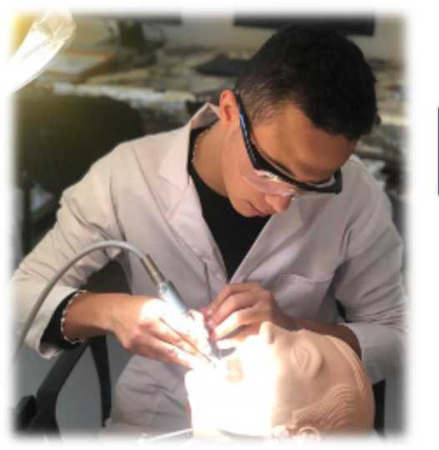
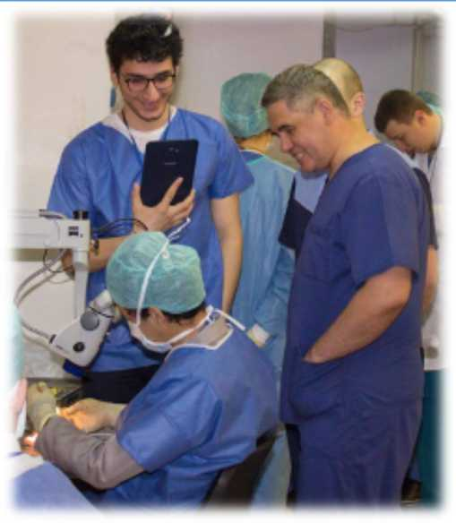
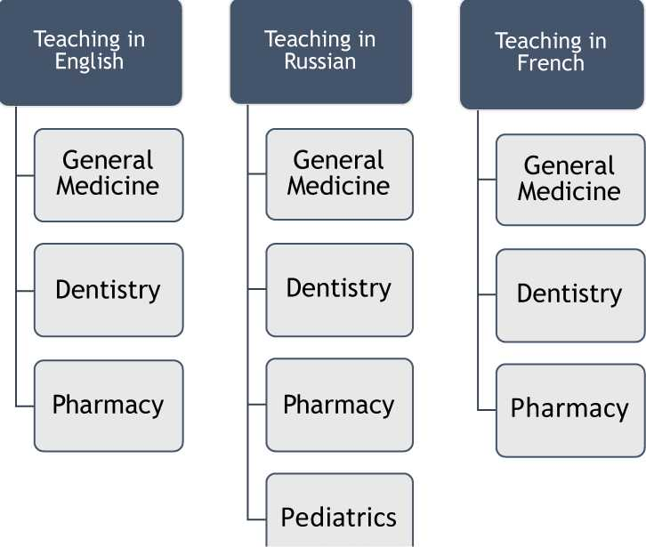
DIRECTIONS OF TRAINING HIGHER EDUCATION

Slide 7
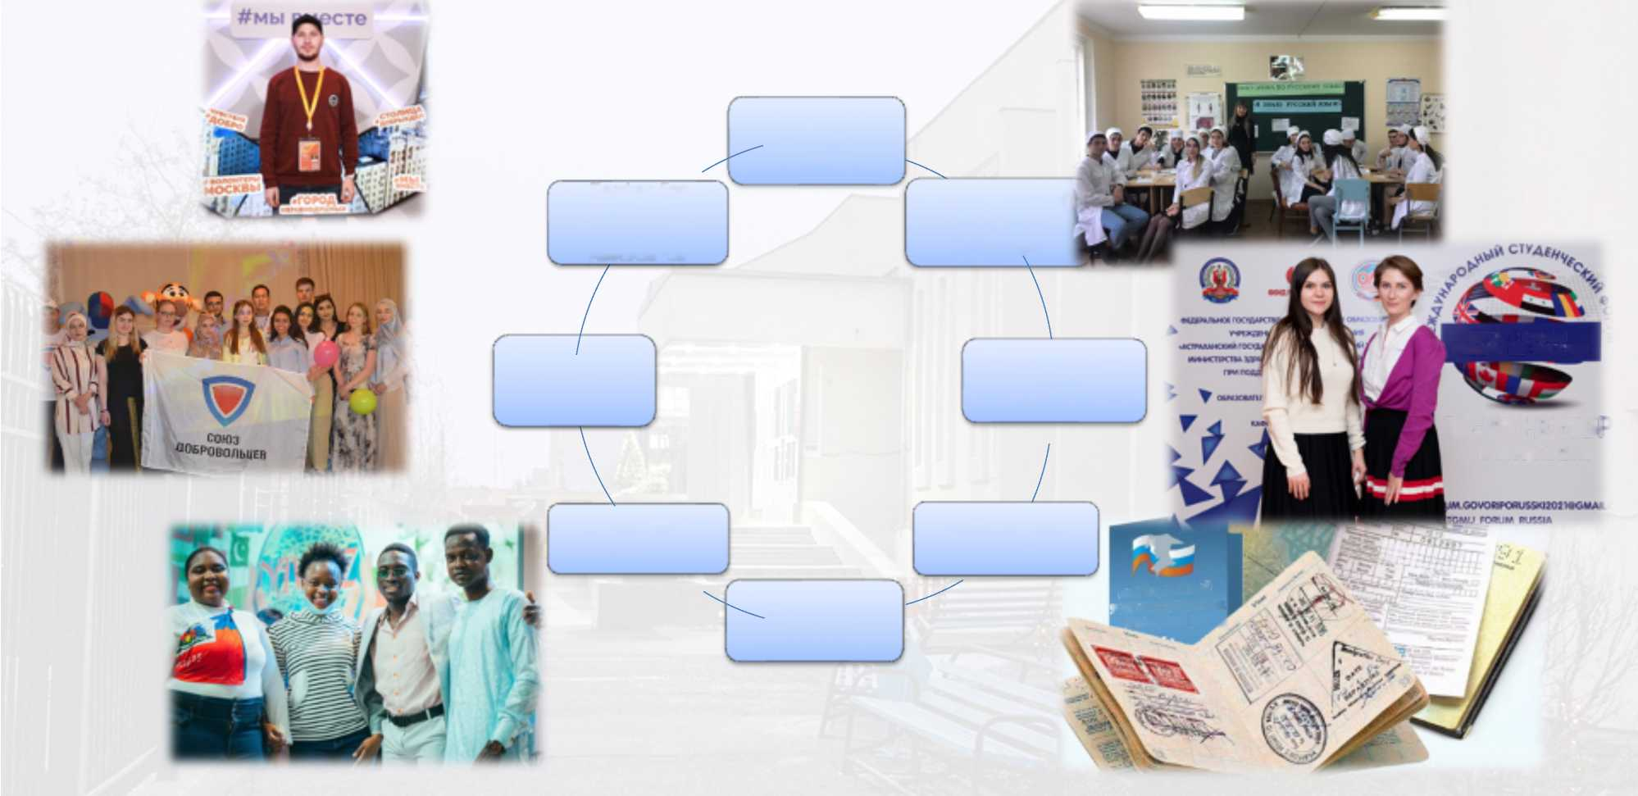
SUPPORT SERVICES FOR FOREIGN STUDENTS
Faculty of Foreign Students
Center for Alumni Employment Assistance
Department of the Russian language
БУДЬ С НАМИ! ГОБОРИ ПО-РУССКИ!
Additional Educational Linguistic Center
Volunteering
16-19 НОЯБ1 г. Астрахань
РОССИИ
Curatorship School
Passport and Visa Department
Mentoring School
миграционный
ИСТ ИНОСТРАННЫХ
ГРАЖДАН В РФ Л

Slide 8


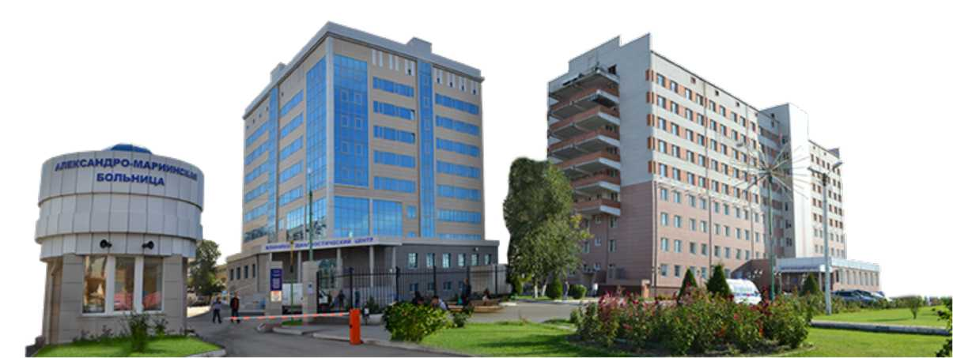
PRACTICE
Astrakhan State Medical University provides a high level of consultative, diagnostic and therapeutic activities, which is carried out in close cooperation with clinical departments and medical institutions of the city and region

Slide 9
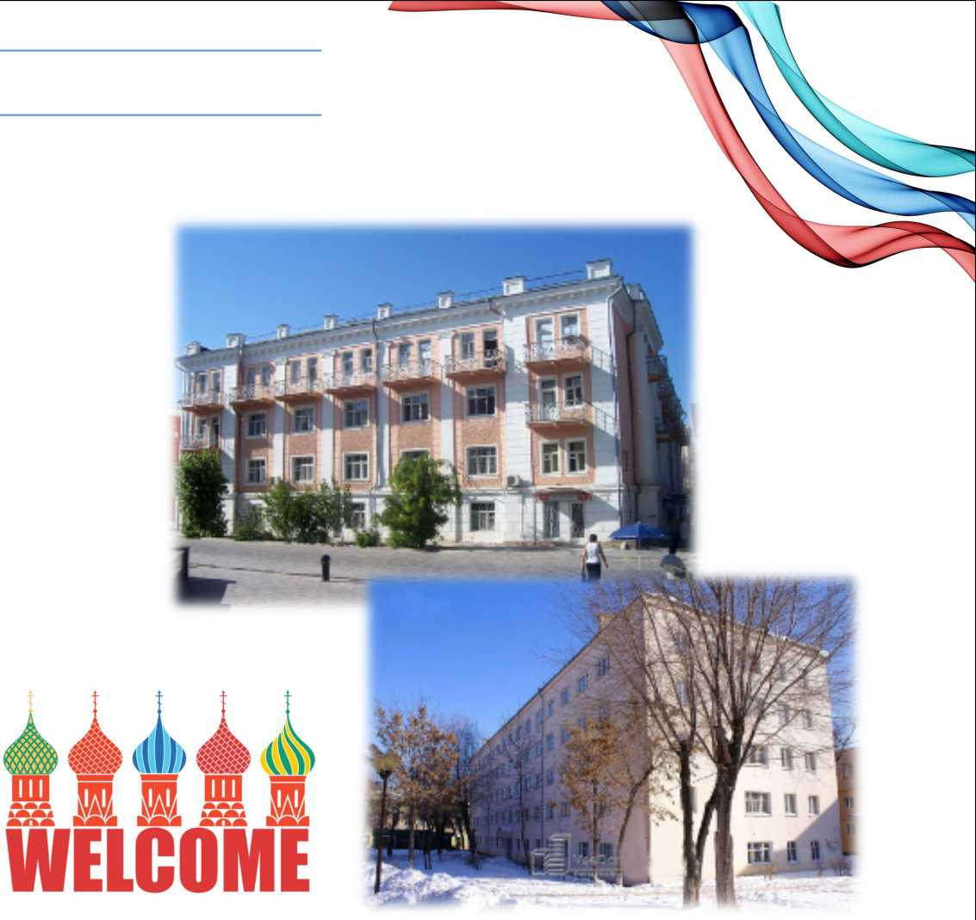
ACCOMODATION
Astrakhan State Medical University has five student hostels for foreign students
In the hostels for common use there are kitchens, showers, washrooms, video surveillance
Hostels No. 1, No. 2, No. 3 - corridor type, No. 4, No. 5 - block type Each hostel has reading rooms
Hostels are located in the city center and are within walking distance from the university

Slide 10
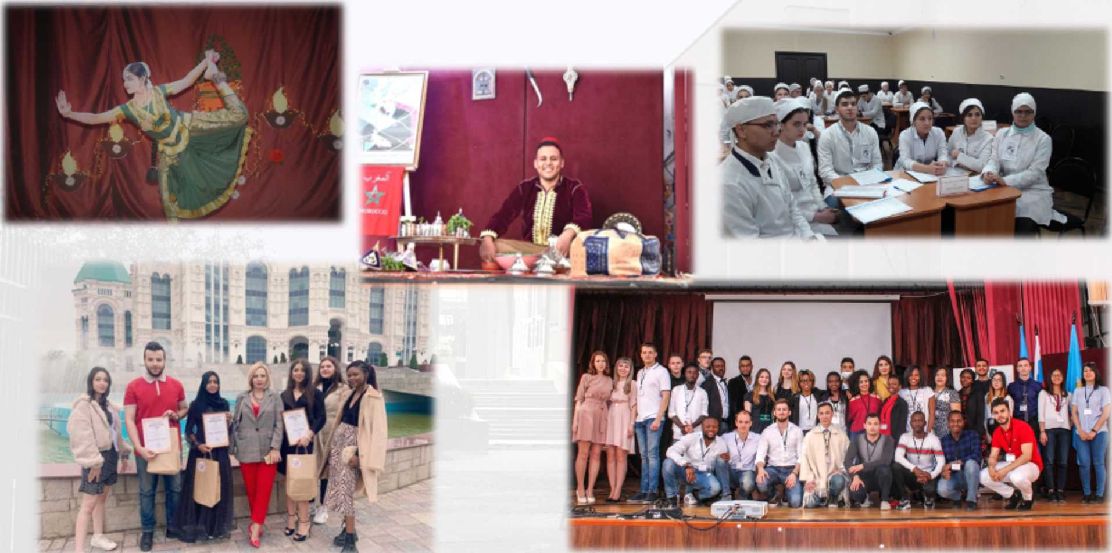
COOPERATION WITH FOREIGN STUDENTS

Slide 11
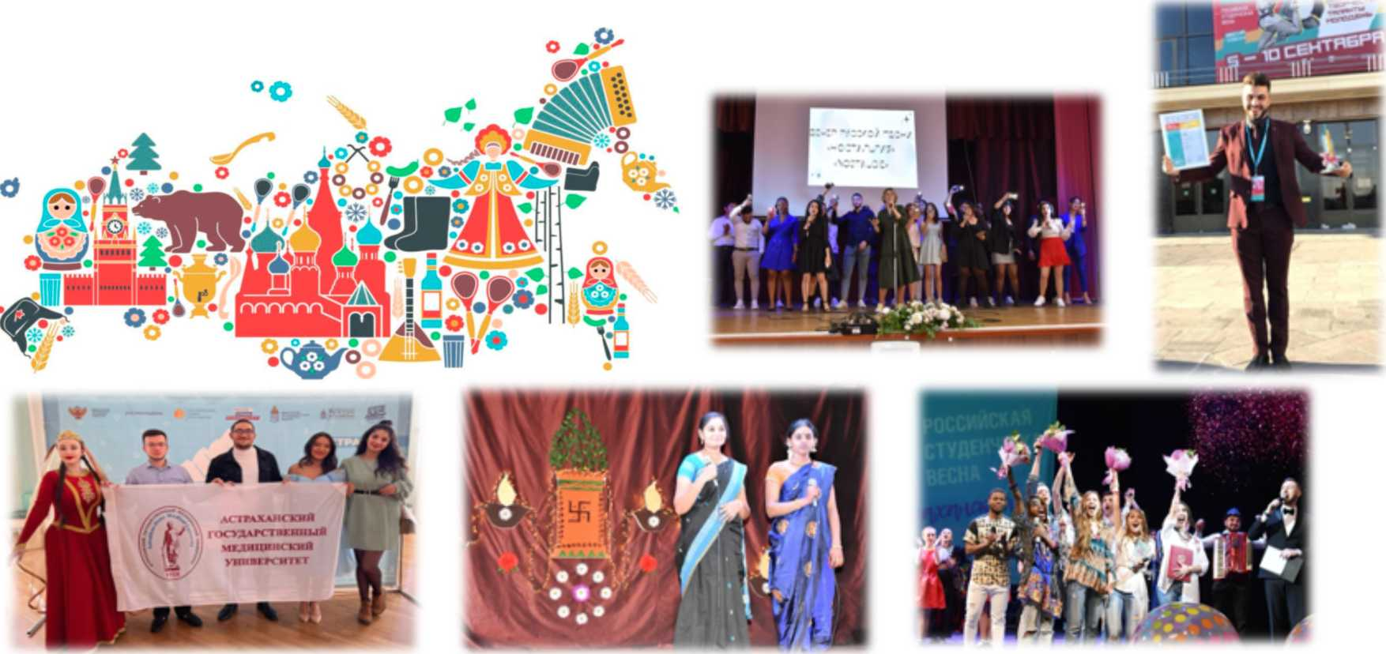
Interesting communication and atmosphere

Slide 12


RECOGNITION OF THE DIPLOMA OF THE ASTRAKHAN STATE MEDICAL UNIVERSITY
More than 100 graduates of the Astrakhan State Medical University have confirmed the equivalence of their diploma in Europe, Africa, Asia, as well as in the USA in the 2021-2022 academic year
ECFMG
A Member of Intealth
Educational Commission for Foreign Medical Graduates
NQA
DATAFLOW
Namibia • Qualifications • Authority

Slide 13

GRADUATION OF FOREIGN STUDENTS
Over 300 international graduates from 29 countries
q 7 diplomas with honors уУ Ceremonial presentation of diplomas

Slide 14
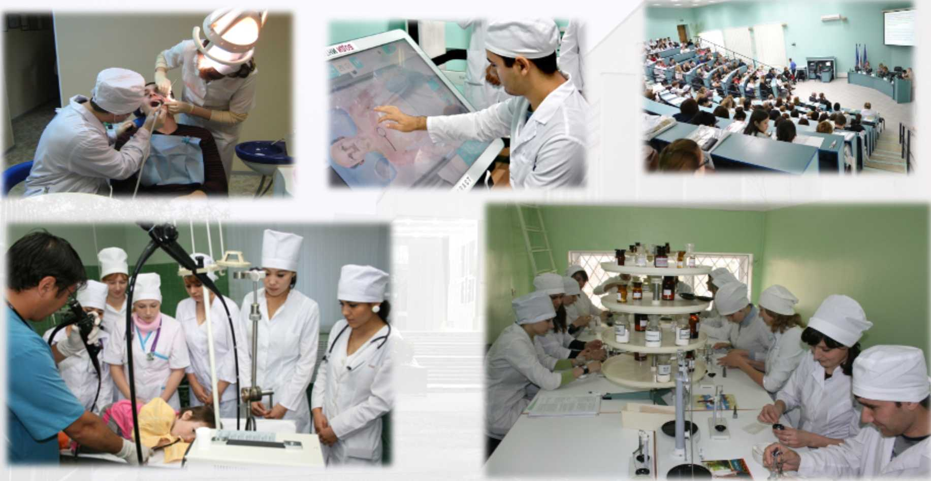
CLINICAL BASES

Slide 15
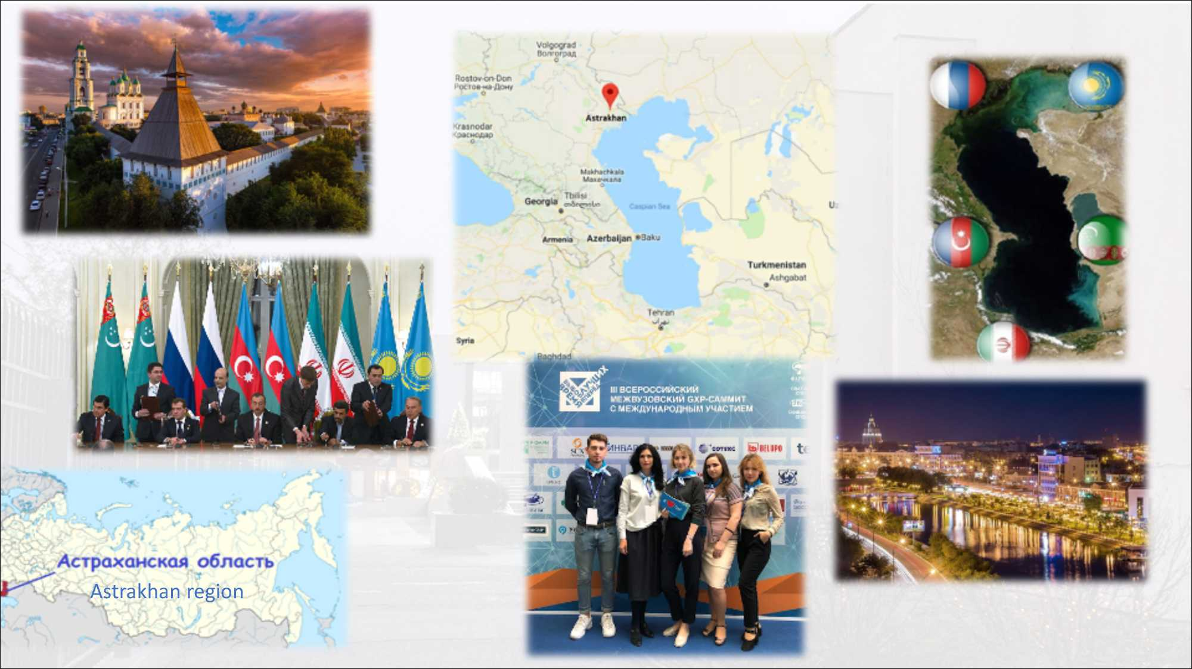

Slide 16


ASTRAKHAN STATE MEDICAL UNIVERSITY
OUR CONTACTS
Website: http://astgmu.ru/
Phone:+7 (8512) 52-41-43
E-mail: post@astgmu.ru;

