Slide 1
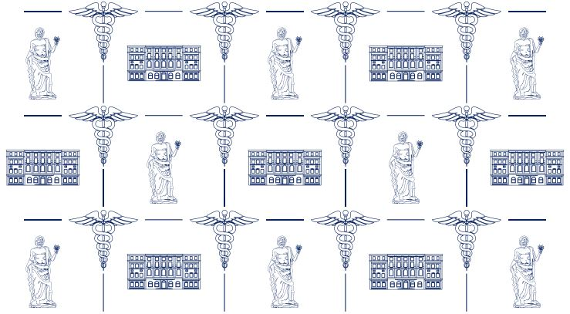



Temporary Residence Permit for Education Purposes (TRPEP)

Slide 2



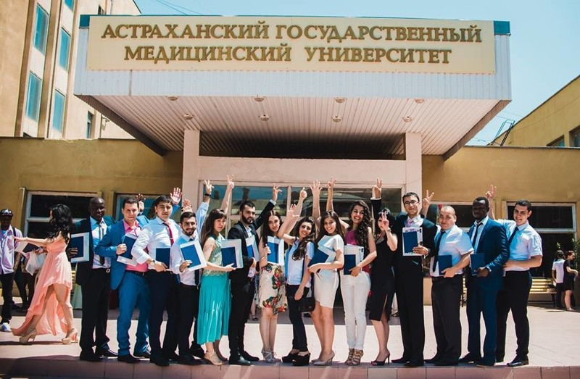
Federal Law №115-FL "On the Legal Status of Foreign Citizens in the Russian Federation"
From 01 January 2023 the order of the Ministry of Internal Affairs of the Russian Federation from 14.12.2022 № 949, approving the Administrative Regulations for the provision of state service for the issuance of foreign citizens and stateless persons temporary residence permit for the purpose of education (hereinafter referred to as TRPEP) came into force.

Slide 3


TRPEP HOLDER'S RIGHTS
A TRPEP is issued for the prescribed period of the training programme, plus 180 (one hundred and eighty) calendar days following the end of the study period.
In obtaining a TRPEP , the student has the right to obtain an OMI (Obligatory Medical Insurance)
It is possible to get a TRPEP only in the region where the university is located.
After the graduation from the university, a TRPEP will be valid for 180 days, during which it is possible to apply for residence permit without leaving the Russian Federation.
Graduates of full-time education, who have previously had a TRPEP will be able to apply for residence permit within 3 years.

Slide 4



WHO CAN GET A TRPEP ?
Citizens undergoing full-time education on programmes:
Specialist programme
Residency training
PhD school (postgraduate study)

Slide 5

LIST OF DOCUMENTS:
Application for issuance of the TRPEP in 2 copies
Identity document
Photos
Documents confirming the status of a student
To be filled in at the migration centre
Passport validity period of at least 3 months prior to expiry at the time of application for TRPEP
2 matte photos 35x45
  Extract from the enrollment order
  Certificate of education
  Copy of the study contract

Slide 6

ALL DOCUMENTS IN A FOREIGN LANGUAGE SHOULD BE ATTACHED TO THE APPLICATION WITH A RUSSIAN TRANSLATION CERTIFIED BY A NOTARY.
Medical records
Medical report from an addiction psychiatrist;
Document confirming the completion of fingerprint registration
‘Green Card’
Criminal record certificate (for visa countries only)
The certificate must not have been issued earlier than 3 months before the date of application.
A receipt for the payment of the state fee
Medical certificate on absence of infectious diseases.
Certificate of absence of HIV-infection;
.
Details and cost of the state fee are on the website https://30.мвд.рф/

Slide 7

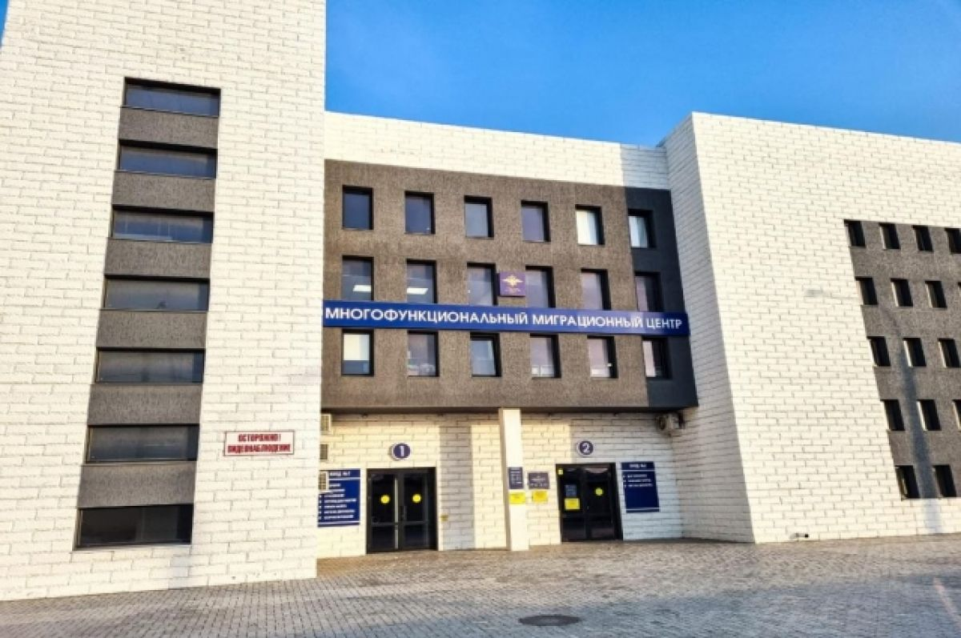
ADDRESS OF THE SERVICE:
Astrakhan, Aeroportovskoe shosse street, bldg 3
Submission of documents for the TRPEP is carried out IN PERSON and only through
PASSPORT-VISA service.
The service is chargeable.
The period of service provision is 38 working days.

Slide 8



TRPEP IS CANCELLED:
After transferring from full-time to part-time study.
When a student is granted an academic leave.
After the end of the academic leave, the learner may reapply for the TRPEP .

Slide 9



IT’S NOT ALLOWED
to be outside the Russian Federation for more than 6 months in total during
a calendar year (from January 1 to December 31)

Slide 10

AMOUNT OF STATE FEE, BANK DETAILS FOR PAYMENT
Bank details for payment of the state fee for issuing a foreign citizen or stateless person a permit for temporary residence in the Russian Federation for the purposes of education
Account - 03100643000000012500
Taxpayer Identification Number (INN)- 3015032610
RCBIC- 011203901
Tax Registration Reason Code (KPP)- 301501001
Russian National Classification of Municipal Territories (OKTMO)- 12701000001
Budgetary classification code- 18810806000010034110
Treasury Single Account: 40102810445370000017
Account 04251513990 Astrakhan Regional Division of the Southern Main Branch of the Central Bank of the Russian Federation, Astrakhan Department Of The Federal Treasury for Astrakhan Region Department of the Ministry of Internal Affairs of Russia for Astrakhan Region
State fee for issuing a foreign citizen or stateless person a permit for temporary residence in the Russian Federation for the purpose of education - 1600 rubles.

Slide 11
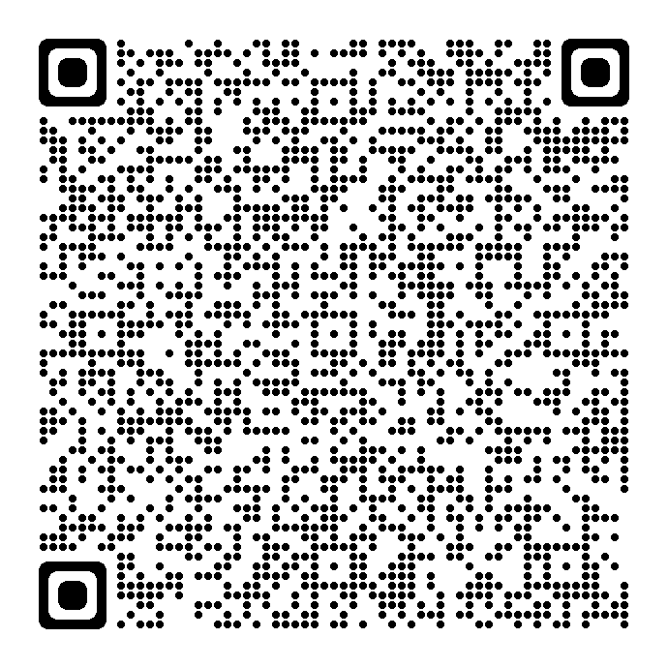
DEPARTMENT OF THE MINISTRY OF INTERNAL AFFAIRS OF RUSSIA FOR THE ASTRAKHAN REGION

Slide 12


ASTRAKHAN STATE MEDICAL UNIVERSITY
Thank you for your attention!

